Slide 1
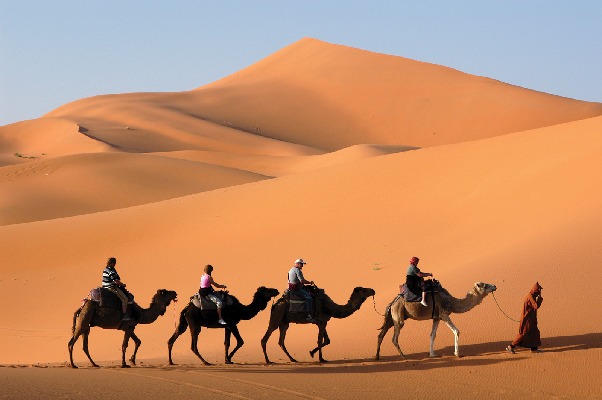

Here you will find videos in Data Science, Python, Personal Finance, Math and more.
As we all know, Camels can go up to six to seven months in the desert without drinking water. Camels also store fat in their humps like we store gasoline in car tanks. When food and water become scarce, camels extract energy from their tanks.
In a similar fashion, Camel Academy enables you to acquire intellect in Technology, Finance, Science and Math, which can add value for the rest of your life.
Welcome to
Camel Academy!
combat - take action to reduce or prevent something bad or undesirable Risk mitigation

Slide 2


I thank you for watching our videos. If you have any questions, please leave them in the comments below. Also, drop a comment if you have any video suggestions.
If you like my videos, then give them a thumbs up and share with your friends. Don’t forget to subscribe if you already haven’t. I know you can do it! Also, please click on the bell button for channel updates.

